Slide 1

Enabling Enterprise
Deposit Management

Slide 2



Today’s panel
John Taylor
Principal, Global Consulting Practice
Experian
Roger Ahern
Decisioning as a Service
Experian
Lauren Makowski
Product Manager
Experian

Slide 3

Enterprise capabilities for deposit management
AGENDA
Deposit industry overview
Experian deposit capabilities
Decision platform
Capabilities planning service
Next steps

Slide 4

Decision
Analytics
DEPOSITS INDUSTRY OVERVIEW
DECISION ANALYTICS

Slide 5
Managing profitable deposits is a challenge in today’s business climate
MANAGING DDA PROFITABILITY
Future pressure to $31B in overdraft-fee
Unclear future for fees and interest rates
DEPOSIT ACCOUNT OPENING
CFPB focus on “fair” account opening
Decision data and platform flexibility a must
REGULATORY COMPLIANCE
CCAR Deposit Forecasting
CFPB focus on fees & transparent decision data
CUSTOMER MANAGEMENT
Affordability monitoring for checking
Optimizing account fees and cross/up sell
CUSTOMER EXPERIENCE
Enabling customer advocates
Instituting customer friendly check policies

Slide 6


Experian’s deposit management capabilities can deliver improved profitability for your portfolio…
How Experian DDA capabilities improve your client profitability
Profit
Targeted Real-Time Credit Cross Sell
Targeting Credit Worthy Higher Balance DDA’s
+$1,000
+$250
Extend time
0
Quality DDA Accounts and
Longer Tenure
-$250
Customer Attrition
Revenue Per Customer
Profit Per Customer

Slide 7
Decision
Analytics
EXPERIAN DEPOSIT MANAGEMENT CAPABILITIES
DECISION ANALYTICS

Slide 8
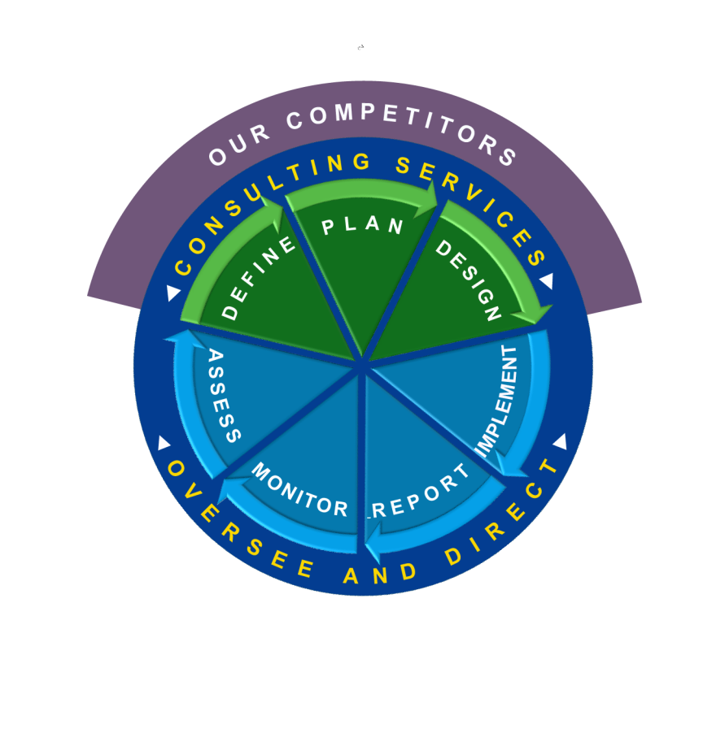

Experian’s approach to capabilities management
COMPETITORS
can only offer a proportion of the services that the Experian Global
Consultants can deliver to their clients
THE EXPERIAN PROCESS
follows a lifecycle approach to their consulting services,
which is always overseen and directed by our experienced consultants
EXPERIAN
Global
Consulting
Practice
DATA
INTEGRITY
INSIGHTS
DATA
ANALYTICS
DECISIONING
MODELING
INTEGRATING

Slide 9

Experian’s deposit account and customer management capabilities
DEPOSIT ACQUISTIONS
DEPOSIT ACCOUNT OPENING
DDA Financial PersonalitiesSM
Wealth Insight ServicesSM
PRECISE ID®
FOR ACCOUNT OPENING
VANTAGE SCORE 3.0
EXTENDED VIEW SCORETM
PREMIER ATTRIBUTESSM
HITWISESM
Decisioning as a ServiceTM
Grow & Retain
DEPOSIT ACCOUNT MANAGEMENT
STRATEGY & PERFORMANCE SERVICE
PRECISE ID®
FOR CUSTOMER MANAGEMENT
Vantage Score 3.0
DELIVERY CONSULTING
GLOBAL CONSULTING
Decisioning as a ServiceTM
PowercurveTM for DDA Customer Management
CUSTOMER EXPERIENCE CONSULTING

Slide 10
Experian’s DDA capabilities
PROSPECTING
Minimize the cost to acquire
by determining the needs and attitudes that drive consumer behavior.
S
P
O
E
R
C
T
P
I
N
G
E
N
S
R
G
T
O
E
C
A
I
N
P
H
T
G
S
A
E
N
R
N
E
L
CREATE
PROSPECT POOL
SEGMENTATION
Identify profitable
look-alike prospects.
CUSTOMER MANAGEMENT
ACCOUNT OPENING
Maximize customer lifetime value
when the consumer is engaged
and in the market to buy.
Confidently authenticate
consumers, reduce risk and
book more profitable accounts.
T
O
R
M
A
U
N
P
E
N
E
M
A
O
N
O
G
C
I
T
E
C
N
S
M
C
O
U
N
A
G
U
S
C
T
E
L
L
-
/
S
U
O
S
P
E
O
-
C
R
S
C
E
A
L
L
N
P
T
A
E
D
N
D
I
OFAC
Compliance
Device
Authentication
Fraud risk
scores
N
Propensity
Scores
Credit scores
Pricing
and line
Offer
optimization
Overdraft
Money
Credit Card
Auto
CDs and
Savings
Unsecured
lines
Mortgage
Debit
Card
Wealth
products
Home
equity
G
FULFILLMENT
CROSS-SELL/UP-SELL
AT POINT OF SALE
DDA CONSULTING SERVICES
Expert insight across the entire DDA customer life cycle

Slide 11
Experian’s approach to deposit acquisitions
Target check account customers using segmentation tools that minimize DDA expense cost to acquire expense and improved activation across all channels.
DEPOSIT ACQUISTIONS SERVICES
WEALTH INSIGHT SERVICESSM
HITWISESM
CUSTOMER EXPERIENCE CONSULTING
DEPOSIT ACQUISITIONS
DDA FINANCIAL PERSONALITIESSM
DDA STRATEGY DESIGN CONSULTING

Slide 12
How Experian improves the effectiveness of our client’s DDA acquisitions process
DEPOSIT ACQUISITIONS SERVICES
HOW WE HELP
Ensure best-in-class targeting methods
Improve response rate, cost-to-acquire with customer friendly processes
Identify high value DDA prospects
DEPOSIT ACQUISITIONS
VALUE DELIVERED
Reduced cost-to-acquire
Improved response rates and activation and on-boarding rates
Increased revenue by identifying DDA customers with cross sell potential
ACQUISITIONS DEVELOPMENT IMPLEMENTATION SERVICE

Slide 13
Experian’s approach to deposit originations that are efficient and comply with CFPB expectations
Comply with CFPB check account screening using nimble check account screening processes to minimize DDA operation compliance expense and improve profit across all channels.
STRATEGY DEVELOPMENT AND IMPLEMENTATION SERVICE
FCRA and NON-FCRA SCORES
WEALTH INSIGHT SERVICESSM
PID for FRAUD and IDENTITY VERIFICATION
DEPOSIT ACCOUNT OPENING
DECISIONING as a SERVICETM PLATFORM
DDA STRATEGY DESIGN CONSULTING

Slide 14
How Experian improves the efficiency of our client’s DDA account origination processes
DEPOSIT ACCOUNT OPENING SERVICES
HOW WE HELP
Capabilities assessment ensuring compliance and efficiency
Implement profitable customer friendly strategies reducing both credit and fraud risk
Enabling real time cross sell of logical products at DDA point-of-sale
DEPOSIT ACCOUNT OPENING
VALUE DELIVERED
Reduced fraud expenses
Improved customer experience from enhanced CIP and KYP processes
Improved revenue with more effective DDA origination processes
STRATEGY DEVELOPMENT IMPLEMENTATION SERVICE

Slide 15

CUSTOMER MANAGEMENT
DECISION ANALYTICS

Slide 16
Experian’s Decisioning as a ServiceTM platform
Automates complex decisions to maximize growth for prospects and new customers by increasing speed, reducing risk, and preventing fraud, while adhering to regulatory standards.
DECISIONING AS A SERVICETM
DDA STRATEGY DESIGN CONSULTING
PRECISE ID®
FOR CUSTOMER MANAGEMENT
CUSTOMER MANAGEMENT
INSTANT PRESCREEN
Vantage Score 3.0
Attribute Toolbox

Slide 17

Decisioning as a Service used after account opening to assess credit-based offers in real-time
Account is opened
“You qualify for a credit card, would
you like to apply?”
A “firm offer of
credit” is required
Company
YES
Real-time inquiry after account opened
(consumer consent is not required)
Qualified?
NO
No action required
Decisioning as a ServiceSM
Soft
inquiry
Attributes
Risk / fraud score(s)
Instant prescreen
decisions
Treatment

Slide 18


Decisioning as a Service enables improved DDA account opening decisions and instant prescreen
DDA account opening system
Inquiry
information
1. Personally identifiable info
2. Device information (if applicable)
3. Existing customer info (if applicable)
1. DDA account-opening decision
2. Instant prescreen decision (s)
3. Wealth management cross-sell
DDA and instant
prescreen decision(s)
Data
Attributes
Scores
Decisions
Treatments
Decisioning as a ServiceSM
(functionality available to support DDA account opening and instant prescreen)
Experian
consumer
OFAC
Check
Premier Attributes
Vantage
Score
Ability-to
Pay Scores
FraudNet
(Device ID)
PowerCurve Strategy Management (decision engine)
PowerCurve Strategy Design Studio (for client-controlled criteria)
Champion / Challenger functionality
FIS
ChexAdvisor
Customer
Data
Trended Attributes
3rd-party data accessed with
Attribute Toolbox
Estimated
Interest Rate
Extended View
Score
Precise ID
(know your customer)
Wealth Insight
Services

Slide 19
DESIGN AND REVIEW SERVICES
DECISION ANALYTICS

Slide 20

Experian’s approach
Acquisitions and originations capabilities review
Two phased approach to determine investment needs to grow deposits
PHASE 1
Assess business CAPABILITIES
Acquisitions, Originations OR Customer Management
Technology, Data, Decision Process SWOT Review
Economic Rationalization of Investment Needs (ROI)
Initiatives Roadmap
STRATEGY DESIGN AND IMPLEMENTATION Plan
Acquisitions, Originations OR Customer Management
Design strategies for single process components
Document implementation platform options
Strategy improvements do not need to impact current
operational processes
PHASE 2
PHASE 1
PHASE 2
20

Slide 21

Deposits Capabilities Assessment and Strategy Design
Phased Implementation Approach
Day 1
TBD
Phase I
REVIEW SERVICES
Planning
Benchmark
Initiative Plan
ROI
Implementation Roadmap
Deposits Capabilities
and Strategy Services
are easily customized
to specific client needs and sophistication
Phase II
DESIGN SERVICES
Client DDA Data
and Process
DDA Challenger
Strategy Testing
Design Documentation and Decision Platform
Combine Experian Design Data
Phase III
CUSTOMER MANAGEMENT SERVICES
Implementation of high-impact initiatives
based on roadmap

Slide 22

The customer experience is important…
    Today, consumers are placing an increasing value on the quality of the customer experience, which is directly tied to customer loyalty and advocacy. Experian’s DDA Strategy will not only help increase profitability, but also improve the customer experience at all points across the customer lifecycle.

Slide 23
Today’s panel
John Taylor
Principal, Global Consulting Practice
Experian
Roger Ahern
Decisioning as a Service
Experian
Lauren Makowski
Product Manager
Experian

Slide 24


